Slide 1
The Amateur’s Code The Radio Amateur is:
CONSIDERATE...never knowingly operates in such a way as to lessen the pleasure of others.
LOYAL...offers loyalty, encouragement and support to other amateurs, local clubs, and the American Radio Relay League, through which Amateur Radio in the United States is represented nationally and internationally.
PROGRESSIVE...with knowledge abreast of science, a well-built and efficient station and operation above reproach.
FRIENDLY...slow and patient operating when requested; friendly advice and counsel to the beginner; kindly assistance, cooperation and consideration for the interests of others. These are the hallmarks of the amateur spirit.
BALANCED...radio is an avocation, never interfering with duties owed to family, job, school or community.
PATRIOTIC...station and skill always ready for service to country and community.
--The original Amateur's Code was written by Paul M. Segal, W9EEA, in 1928.

Slide 2
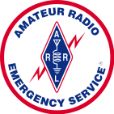
Part 2 Amateur Radio Public Service Communications Interpreting The Rules
Part 1 ARRL Official Observer Program Amateur Auxiliary to the FCC’s Enforcement Bureau

Slide 3
ARRL Official Observer Program Amateur Auxiliary to the FCC’s Enforcement Bureau
Roy Rabey, AD5KZ
ARRL North Texas Section OOC

Slide 4
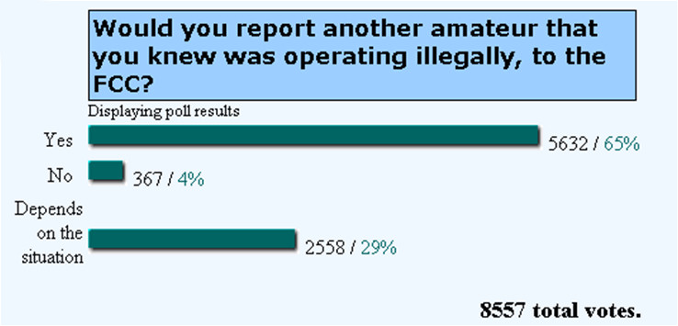

Slide 5
The Answer Is No. Why?
The FCC expects the Amateur Radio Service to be self policing and self regulating.
We are responsible for interpreting the rules in a responsible manner.
The FCC would prefer their resources to be used for other services.
We would prefer to be in control of our own destiny.

Slide 6
The Amateur Auxiliary is the proper channel for resolution of rules violations within the Amateur Radio Service.

Slide 7
What is the Amateur Auxiliary?
An official auxiliary of the FCC.
Organization of volunteer Official Observers (OOs) administered by the ARRL.
Monitor the ham bands for opportunities to assist hams with operating and technical issues.
Help resolve issues that if chronic might get the attention of the FCC.
Notify amateurs by mail of operating or technical irregularities.
Collect, evaluate and prepare evidence for submission to the FCC’s enforcement bureau.

Slide 8
Communications Act Amendments of 1982
In 1982 Congress passed the Communications Amendments Act of 1982 (Public Law 97-259). It authorizes the FCC to use volunteers to monitor the airwaves for rules violations.
As the result of an agreement between the FCC and ARRL, the Amateur Auxiliary was created.
The Amateur Auxiliary has legal status and legal protection.
Evidence gathered by the Amateur Auxiliary is valid in court cases.

Slide 9
Purposes of the Amateur Auxiliary
Foster a wider knowledge of and compliance to the laws, rules & regulations of the Amateur Radio Service.
Extend the concepts of self regulation and self administration of the Amateur Radio Service (Self Policing).
Enhance the opportunity for individual amateurs to contribute to the public welfare.
Enable the FCC to efficiently and effectively utilize its manpower and resources.

Slide 10
The ARRL Field Organization
Section Field Org.
Section Manager
Emergency Com.
(ARES)
SEC
National Traffic System
STM
Affiliated Club Support
AAC
Public Information
PIC
Official Observers
OOC
Technical Services
TC
Government Liaison
SGL

Slide 11
Organization of the Amateur Auxiliary
ARRL HQ
Field & Regulatory Correspondent
FCC
Section Manager
Official Observer Coordinator
Official Observers
Local Interference Committees
Two
Primary Roles

Slide 12
Official Observer
ARRL Member
Technician 4 years
Apply for Station Appointment
Recommended by SM or OOC
Successfully complete an open-book exam

Slide 13
Local Interference Committee
Members should be respected and accepted within the amateur community
Members selected by clubs
RDF Experience
Repeater Experience
Chairman is an OO and works with OOC
Sanctioned by SM

Slide 14
How necessary is the Amateur Auxiliary to the FCC?
We would like to think its not really needed.
But intentional and unintentional rules violations are a reality.
The FCC can’t be the first responders.
Amateur Radio must be self policing.
No program will cure all the ills of our bands.

Slide 15
We’re All Human (Our equipment isn’t perfect either)
Most of us would rather hear about a problem from a fellow ham who is trying to help, rather than the FCC.
Sadly, we know that there are exceptions.

Slide 16
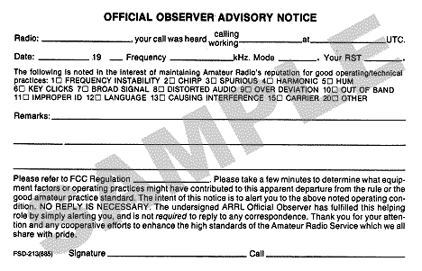
Advisory Notice

Slide 17
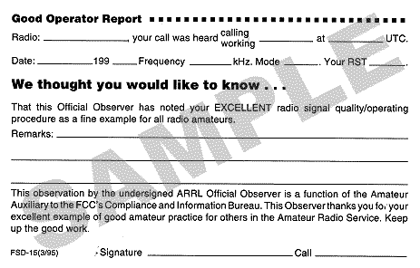
Good Operator Report

Slide 18
What to do if you encounter a problem on the air.
Record the violation!
Don’t take any notice of it on the air.
Listen to the input and log the time, date, your location, signal strength, and conditions, etc.
Discuss your findings OFF AIR with the Local Interference Committee or OO.
Record the violation! - Because if it’s not recorded, it never happened as far as the FCC is concerned.

Slide 19
The Typical Escalation Process (When a case is deemed to be a serious repeated problem.)
FCC takes appropriate enforcement actions.
After HQ review, package sent to the FCC.
Evidence package prepared for HQ.
OOC reviews evidence & consults with ARRL HQ. May send letter when authorized by HQ.
OO sends Advisory Notice and reports activities to OOC then continues to collects more information.
Interference Committee or individuals bring detailed information (and recordings) to OO.

Slide 20
Getting Involved With The Official Observer Program
Understand the program and assist.
Contribute as an individual.
Join/Create a Local Interference Committee.
RDF Team
Technical skills and equipment
Become an Official Observer.
ARRL Member.
4 years as Technician Class or higher.
Pass open-book exam (Amateur Auxiliary Training Manual, FCC Rules, ARRL Handbook).

Slide 21
By Getting Involved You…
Protect the Amateur Radio Service.
Help your fellow hams.
When necessary, gather evidence used to justify FCC enforcement action.

Slide 22
Summary
The Amateur Auxiliary is there to help.
Official Observers protect the Amateur Radio Service by offering guidance and problem resolution.
Part 97 and RO’s from FCC allow for well thought out, responsible rules interpretations.
We are expected to study the FCC rules and apply critical thinking to the facts at hand.
We must be self regulating and self policing.
We should not engage the FCC unless absolutely necessary.
Use ARRL resources.

Slide 23
Questions?
Roy Rabey, AD5KZ
ARRL Official Observer Coordinator, NTX
ad5kz@arrl.net

Slide 24
Amateur Radio Public Service Communications
Interpreting The Rules

Slide 25
The Big Issues
Public service communications is an important part of the Amateur Radio Service.
Professional public safety personnel are being licensed in record numbers.
Can these people use amateur radio when their employer is involved?
How do we protect our spectrum while we are constantly demonstrating its’ value?

Slide 26
Amateur Radio & Professional Public Service
§ 97.111 Authorized transmissions.
(a) An amateur station may transmit the following types of two-way communications:
(2) Transmissions necessary to meet essential communication needs and to facilitate relief actions.
§97.113 Prohibited transmissions
(a) No amateur station shall transmit
(2) Communications for hire or for material compensation, direct or indirect, paid or promised, except as otherwise provided in these rules.
(3) Communications in which the station licensee or control operator has a pecuniary interest, including communications on behalf of an employer.
(5) Communications, on a regular basis, which could reasonably be furnished alternatively through other radio services.

Slide 27
Prohibited Transmissions Exceptions
§97.113 goes on to make two exceptions to paragraphs (a)(2) and (a)(3), as follows:
(c) A control operator may accept compensation as an incident of a teaching position during periods of time when an amateur station is used by that teacher as a part of classroom instruction at an educational institution.
(d) The control operator of a club station may accept compensation for the periods of time when the station is transmitting telegraphy practice or information bulletins, provided that the station transmits such telegraphy practice and bulletins for at least 40 hours per week; schedules operations on at least six amateur service MF and HF bands using reasonable measures to maximize coverage; where the schedule of normal operating times and frequencies is published at least 30 days in advance of the actual transmissions; and where the control operator does not accept any direct or indirect compensation for any other service as a control operator.
Teachers
ARRL/ W1AW

Slide 28
How do we know what is legal?
The FCC has declined to provide a list of all permitted and prohibited transmissions.
We are expected to study the Rules and apply critical thinking to the facts at hand.

Slide 29
Resolving The Gray Areas
§97.1 Basis and purpose.
The rules and regulations in this Part are designed to provide an amateur radio service having a fundamental purpose as expressed in the following principles:
(a) Recognition and enhancement of the value of the amateur service to the public as a voluntary noncommercial communication service, particularly with respect to providing emergency communications.
(b) Continuation and extension of the amateur's proven ability to contribute to the advancement of the radio art.
(c) Encouragement and improvement of the amateur service through rules which provide for advancing skills in both the communications and technical phases of the art.
(d) Expansion of the existing reservoir within the amateur radio service of trained operators, technicians, and electronics experts.
(e) Continuation and extension of the amateur's unique ability to enhance international goodwill.
Recognition
Promo/Demo
Public Service
Emergency Comm.
Rules
Encourage
Improve
Advance Skills

Slide 30
How do we know what is legal?
Perform evaluation of radio operations based on several key elements of the Amateur Radio Service Rules…
No compensation or pecuniary interest.
Fulfilling part §97.1 (Basis and Purpose).
Working for the Public Interest.
Emergency Communications
Protecting our spectrum.

Slide 31
How do we know what is legal?
Utilizing beneficial opportunities for public service communications and showcasing the continued relevance and importance of Amateur Radio communications to the public (§ 97.1).
Allowing organizations to exploit Amateur Radio as a cheap and flexible alternative to other radio services.
Fine Line

Slide 32
Providing legal Amateur Radio communications
A good rule of thumb when evaluating a particular request for communications support is to ask…
Who benefits?
Are we fulfilling §97.1 (Basis and Purpose)?
If public safety is the principal beneficiary, then §97.1 is being fulfilled.
If demonstrating and promoting Amateur Radio, then §97.1 is being fulfilled.
If the entity itself and not the general public is the principal beneficiary, then they should be encouraged to use radio services other than Amateur Radio.

Slide 33
Providing legal Amateur Radio communications to your employer?
Yes
Your employer provides disaster relief AND you are engaged in disaster relief operations
No
Your employer provides disaster relief AND you are training for disaster relief operations
Your employer is not in the business of providing disaster relief

Slide 34
Amateur Radio & Professional Public Service
The FCC’s Report and Order, FCC 06-149, 21 FCC Rcd.11643, released October 10, 2006, clarifies the rules for employees by stating that…
“Section 97.113 does not prohibit amateur radio operators who are emergency personnel engaged in disaster relief from using the amateur service bands while on paid duty status.
These individuals are not receiving compensation for transmitting amateur service communications; rather, they are receiving compensation for services related to their disaster relief duties and in their capacities as emergency personnel.”

Slide 35
Amateur Radio & Professional Public Service
This is not an "exception" to the "no communications on behalf of an employer" rule – it is simply recognition of the public benefit of Amateur Radio stated in the Basis and Purpose section of the Rules at §97.1(a).
Paid emergency personnel who are licensed amateurs and who find themselves needing to use amateur radio in disaster relief may do so.
This applies only to “emergency personnel engaged in disaster relief.” It does not apply to training exercises or drills.
It does not apply to employees of entities that may encounter business disruptions but which are not in the business (either for-profit or non-profit) of providing disaster relief.

Slide 36
Some fine points
Some Amateurs believe that communications on behalf of one’s employer are allowed if the business is not for profit, or if the communications are transmitted outside the employee’s regular working hours.
Rules do not distinguish between for-profit and non-profit organizations.
Rules say nothing about the employee’s working hours or paid duty status.
Rules prohibit all communications on behalf of one’s employer, save for two very narrow exceptions [97.113(c) and (d)].
Rules do not prohibit the recreational use of Amateur Radio by employees at a station located in the workplace, including club stations.
As long as employees are not communicating on behalf of their employer, i.e., doing their employer's business on the air, there is nothing illegal about the operation of these stations on the employer's premises.

Slide 37
Why not ask the FCC to decide for us?
The FCC has, for the most part, very clearly put the determination of what communications are proper in the hands of amateurs themselves.
The FCC has declined to give us a list of what events are legal.
Devotion of the FCC’s resources to detailed analysis and evaluation of hundreds of diverse projects and proposals is not a realistic expectation.
Appeals by well-meaning Amateurs to the FCC for rules interpretations undercut our argument that the Amateur Radio Service should be trusted to experiment with a great degree of freedom, largely regulate our own activities, and appeal to the FCC for regulation and enforcement only when all other options have been exhausted.

Slide 38
Why not ask the FCC to decide for us?
In the past, when the FCC staff has been informally asked detailed questions about what is and is not legal, the outcome has been inconsistent and on occasion undesirable.
In some cases, restrictive interpretations have been given that hindered our freedom to experiment, innovate, and serve the public interest.
In some other cases, permissive interpretations have been given that were later reversed by the FCC, causing confusion.
Rather than ask FCC staff for interpretations, which are unofficial, Amateurs should rely on the text of the FCC’s Rules and on official Report and Order documents.
The ARRL has an entire department available to assist with these kinds of questions.

Slide 39
Review
No pay for providing communications.
No communications on behalf of employer (§97.113).
Emergency personnel during disaster relief permitted.
Employee can use employer club station when not communicating on behalf of employer.
No difference between employee on or off the clock.
No difference between profit or non-profit entity.
No business continuity communications for entities not in the business of disaster relief.
Fulfill §97.1 (Basis and Purpose).
Use critical thinking to interpret the rules and R&O documents.

Slide 40
Scenario Discussion
Critical thinking is purposeful and reflective judgment about what to believe or what to do in response to observations, experience, verbal or written expressions, or arguments.
Let’s use or critical thinking and what we have learned to discuss some scenarios.

Slide 41
ARRL Official Observer Program Amateur Auxiliary to the FCC’s Enforcement Bureau
Thank You!
Roy Rabey, AD5KZ
ARRL North Texas Section OOC
ad5kz@arrl.net

